Slide 1

FED
WE
E
K
CSS Layout with Flexbox and Grid
Responsive Web Design
Front End Development
Diploma in IT & ISF
Year 1 (2018/19), Semester 2
5

Slide 2
Topics
CSS Flexbox
Setting up Flexbox Container
Controlling Flow in Flexbox Container
Controlling Alignment of Flex Items in Container
CSS Grid Layout
How Grid Layout Works
Setting up Grid Layout
Placing Grid Items
Responsive Web Design
Why Responsive Web Design?
Media Queries

Slide 3
Learning Objectives
Using Flexbox to control the flow and alignment of items on web pages
Using Grid layout to design multi-columns web pages
Applying Flexbox and Grid Layout, together with Media Queries to design web pages that are responsive to various device screen sizes.

Slide 4
Introduction to Flexbox
Before the Flexbox Layout, there were four layout modes:
Block, for sections in a webpage
Inline, for text
Table, for two-dimensional table data
Positioned, for explicit position of an element
Flexbox Layout makes it easier to design flexible responsive layout structure without using float or positioning.

Slide 5

Introduction to Flexbox
A Flexible Layout must have a parent element with the display property set to flex.
Direct child elements(s) of the flexible container automatically becomes flexible items.
Example:
<style> .flex-container { display: flex; background-color: Blue; } .flex-container > div { background-color: #f1f1f1; font-size: 30px; margin: 10px; padding: 20px; } </style> <div class="flex-container"> <div>1</div> <div>2</div> <div>3</div> </div>

Slide 6
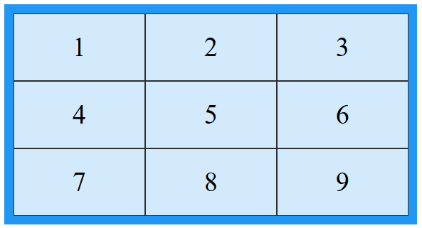
Introduction to Grid Layout
CSS Grid Layout offers a grid-based layout system, with rows and columns, making it easier to design web pages without having to use floats and positioning.
Example:
<style>
.grid-container { display: grid; background-color: #2196F3; padding: 10px;
grid-template-columns: auto auto auto; }
.grid-item {
background-color: rgba(255, 255, 255, 0.8); font-size: 30px; text-align: center;
border: 1px solid rgba(0, 0, 0, 0.8);
padding: 20px; }
</style>
<div class="grid-container">
<div class="grid-item">1</div>
. . . . . . . . . . . . . . . . . . . . . . . .
<div class="grid-item">9</div>
</div>

Slide 7
Responsive Web Design
Responsive web design makes your web page look good on all devices.
Responsive web design uses 3 core components:
A flexible grid
Responsive sites use methods that allow them to squeeze and flow into the available browser space.
Flexible images
Images and other embedded media need to be able to scale to fit their containing elements.
CSS media queries
Media queries give us a way to deliver sets of rules only to devices that meet certain criteria, such as width and orientation.

Slide 8
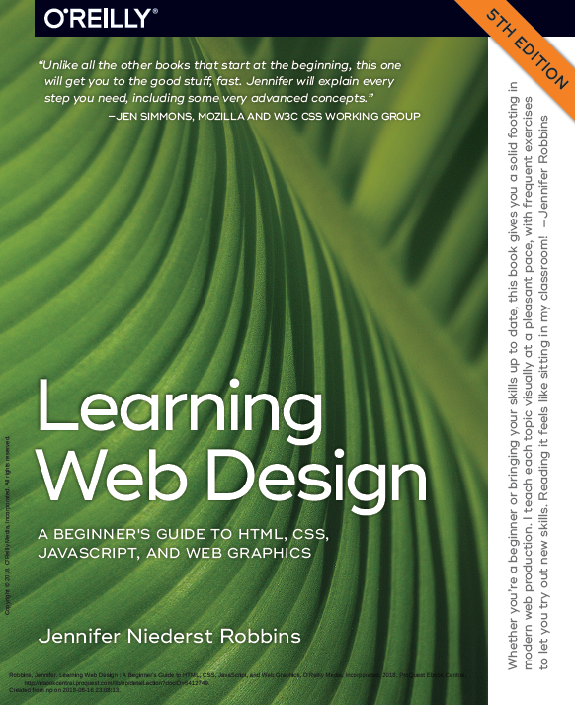
Reference
Learning Web Design
A Beginner’s Guide to HTML, CSS, JavaScript and Web Graphics
Jennifer Niederst Robbins
Chapter 16 to 17
Available to download from NP library:
https://ebookcentral-proquest-com.libproxy.np.edu.sg/lib/np/detail.action?docID=5412749
Lynda.com:
CSS Essentials Training 2

Slide 9
Activities
Read Part III – CSS for Presentation (Chapters 16, 17) from the textbook and follow the exercises in these 2 chapters.
Complete Week 5 Practical – 4 tasks.
Submit the completed practical files in Week5Practical folder to your folder in //ictspace/FED.
If you have any questions please communicate with your tutor via Microsoft Teams.
Reference materials:
Chapter 16 – CSS Layout with Flexbox and Grid
Chapter 17 – Responsive Web Design
Lynda.com video course: CSS Essentials Training 2 (https://www.lynda.com/CSS-tutorials/CSS-Essential-Training-2/569189-2.html)

